Slide 1
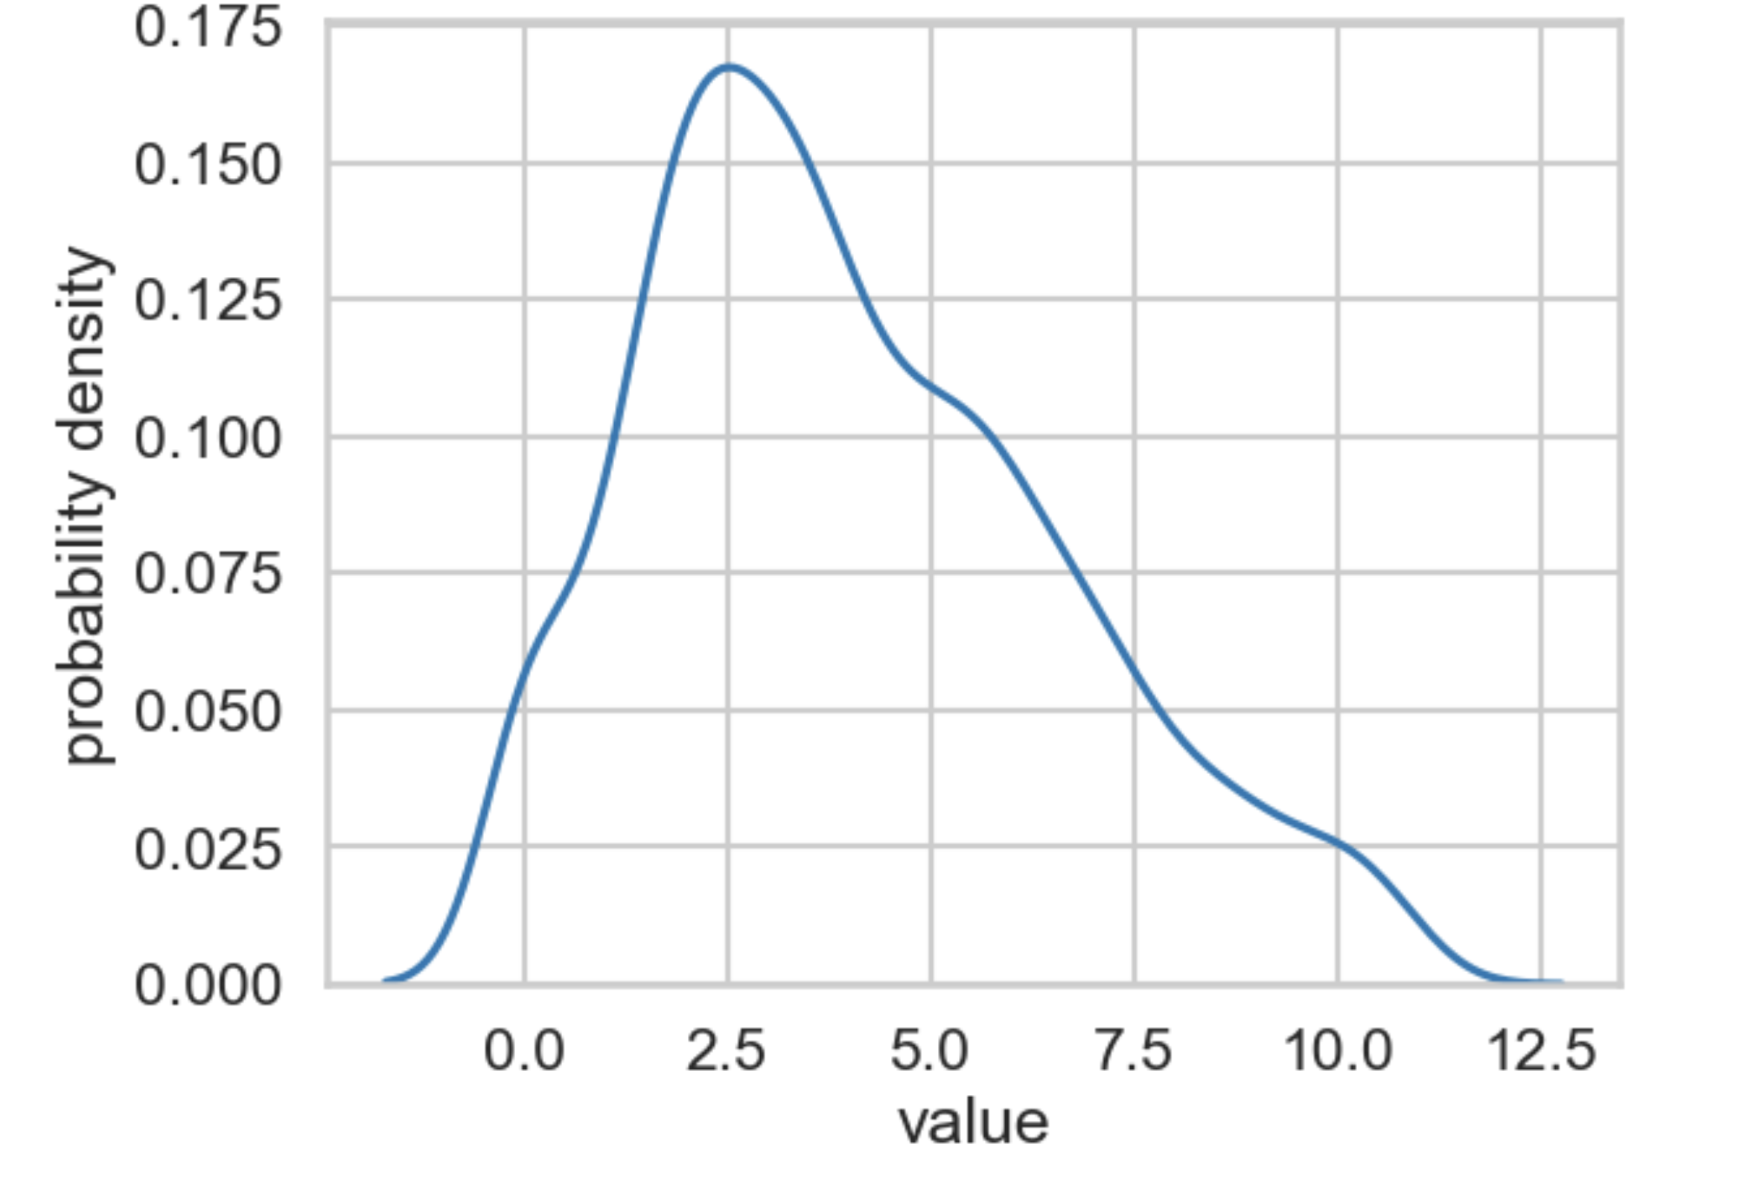

Slide 2
median
mode
mean

Slide 3
Population
The relative likelihood of all possible values of a variable
Sample
A subset of data drawn from a population

Slide 4
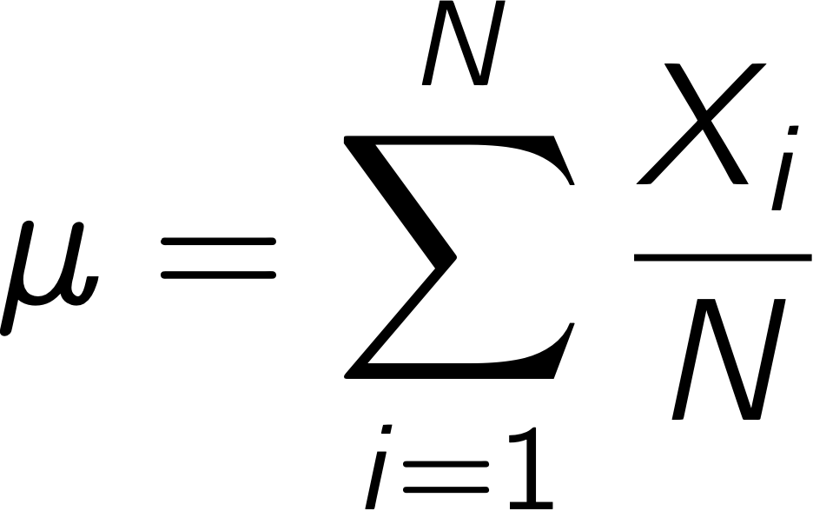
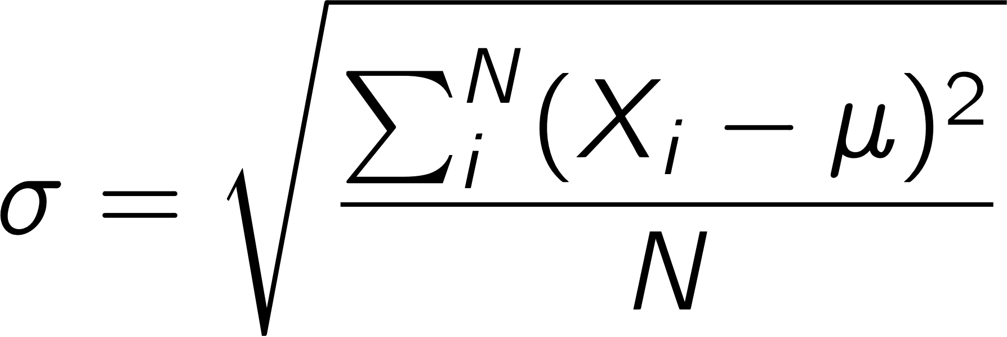

mean (𝜇) standard deviation ($σ$)

Slide 5
0
0

Slide 6
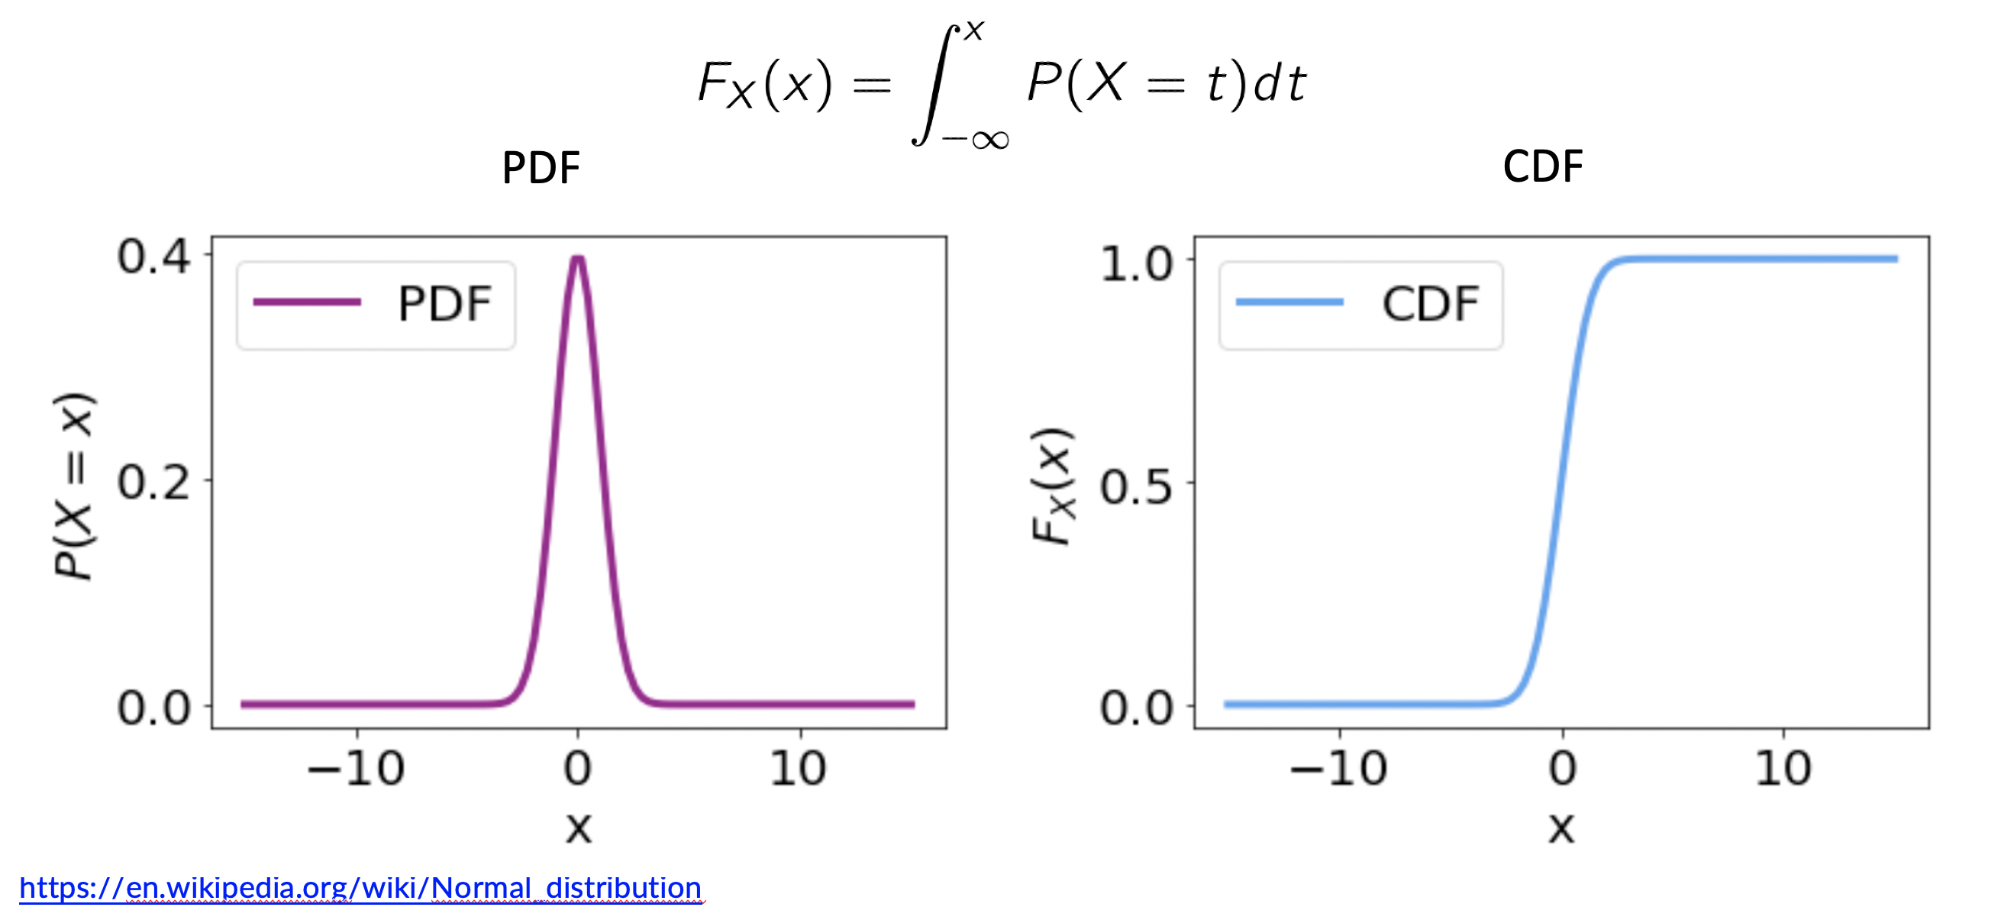

Slide 7
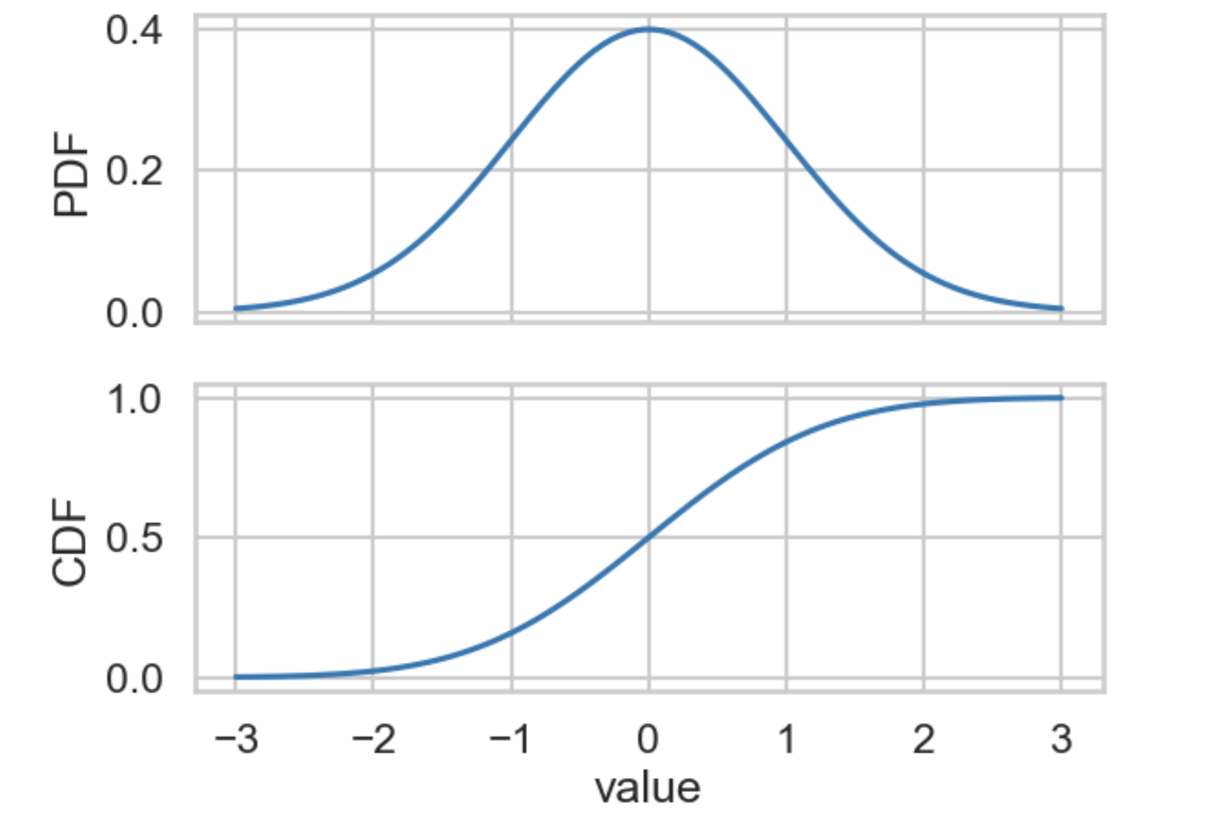

Slide 8
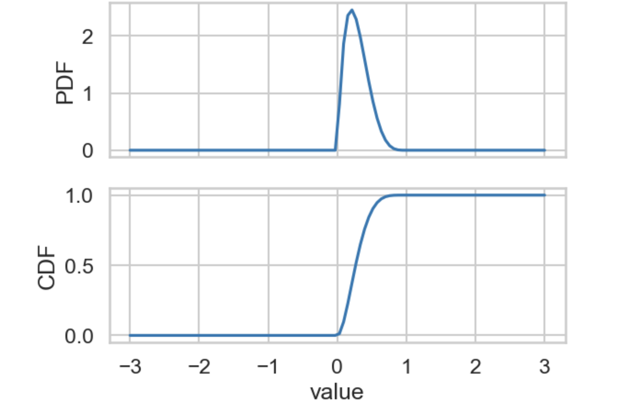

Slide 9
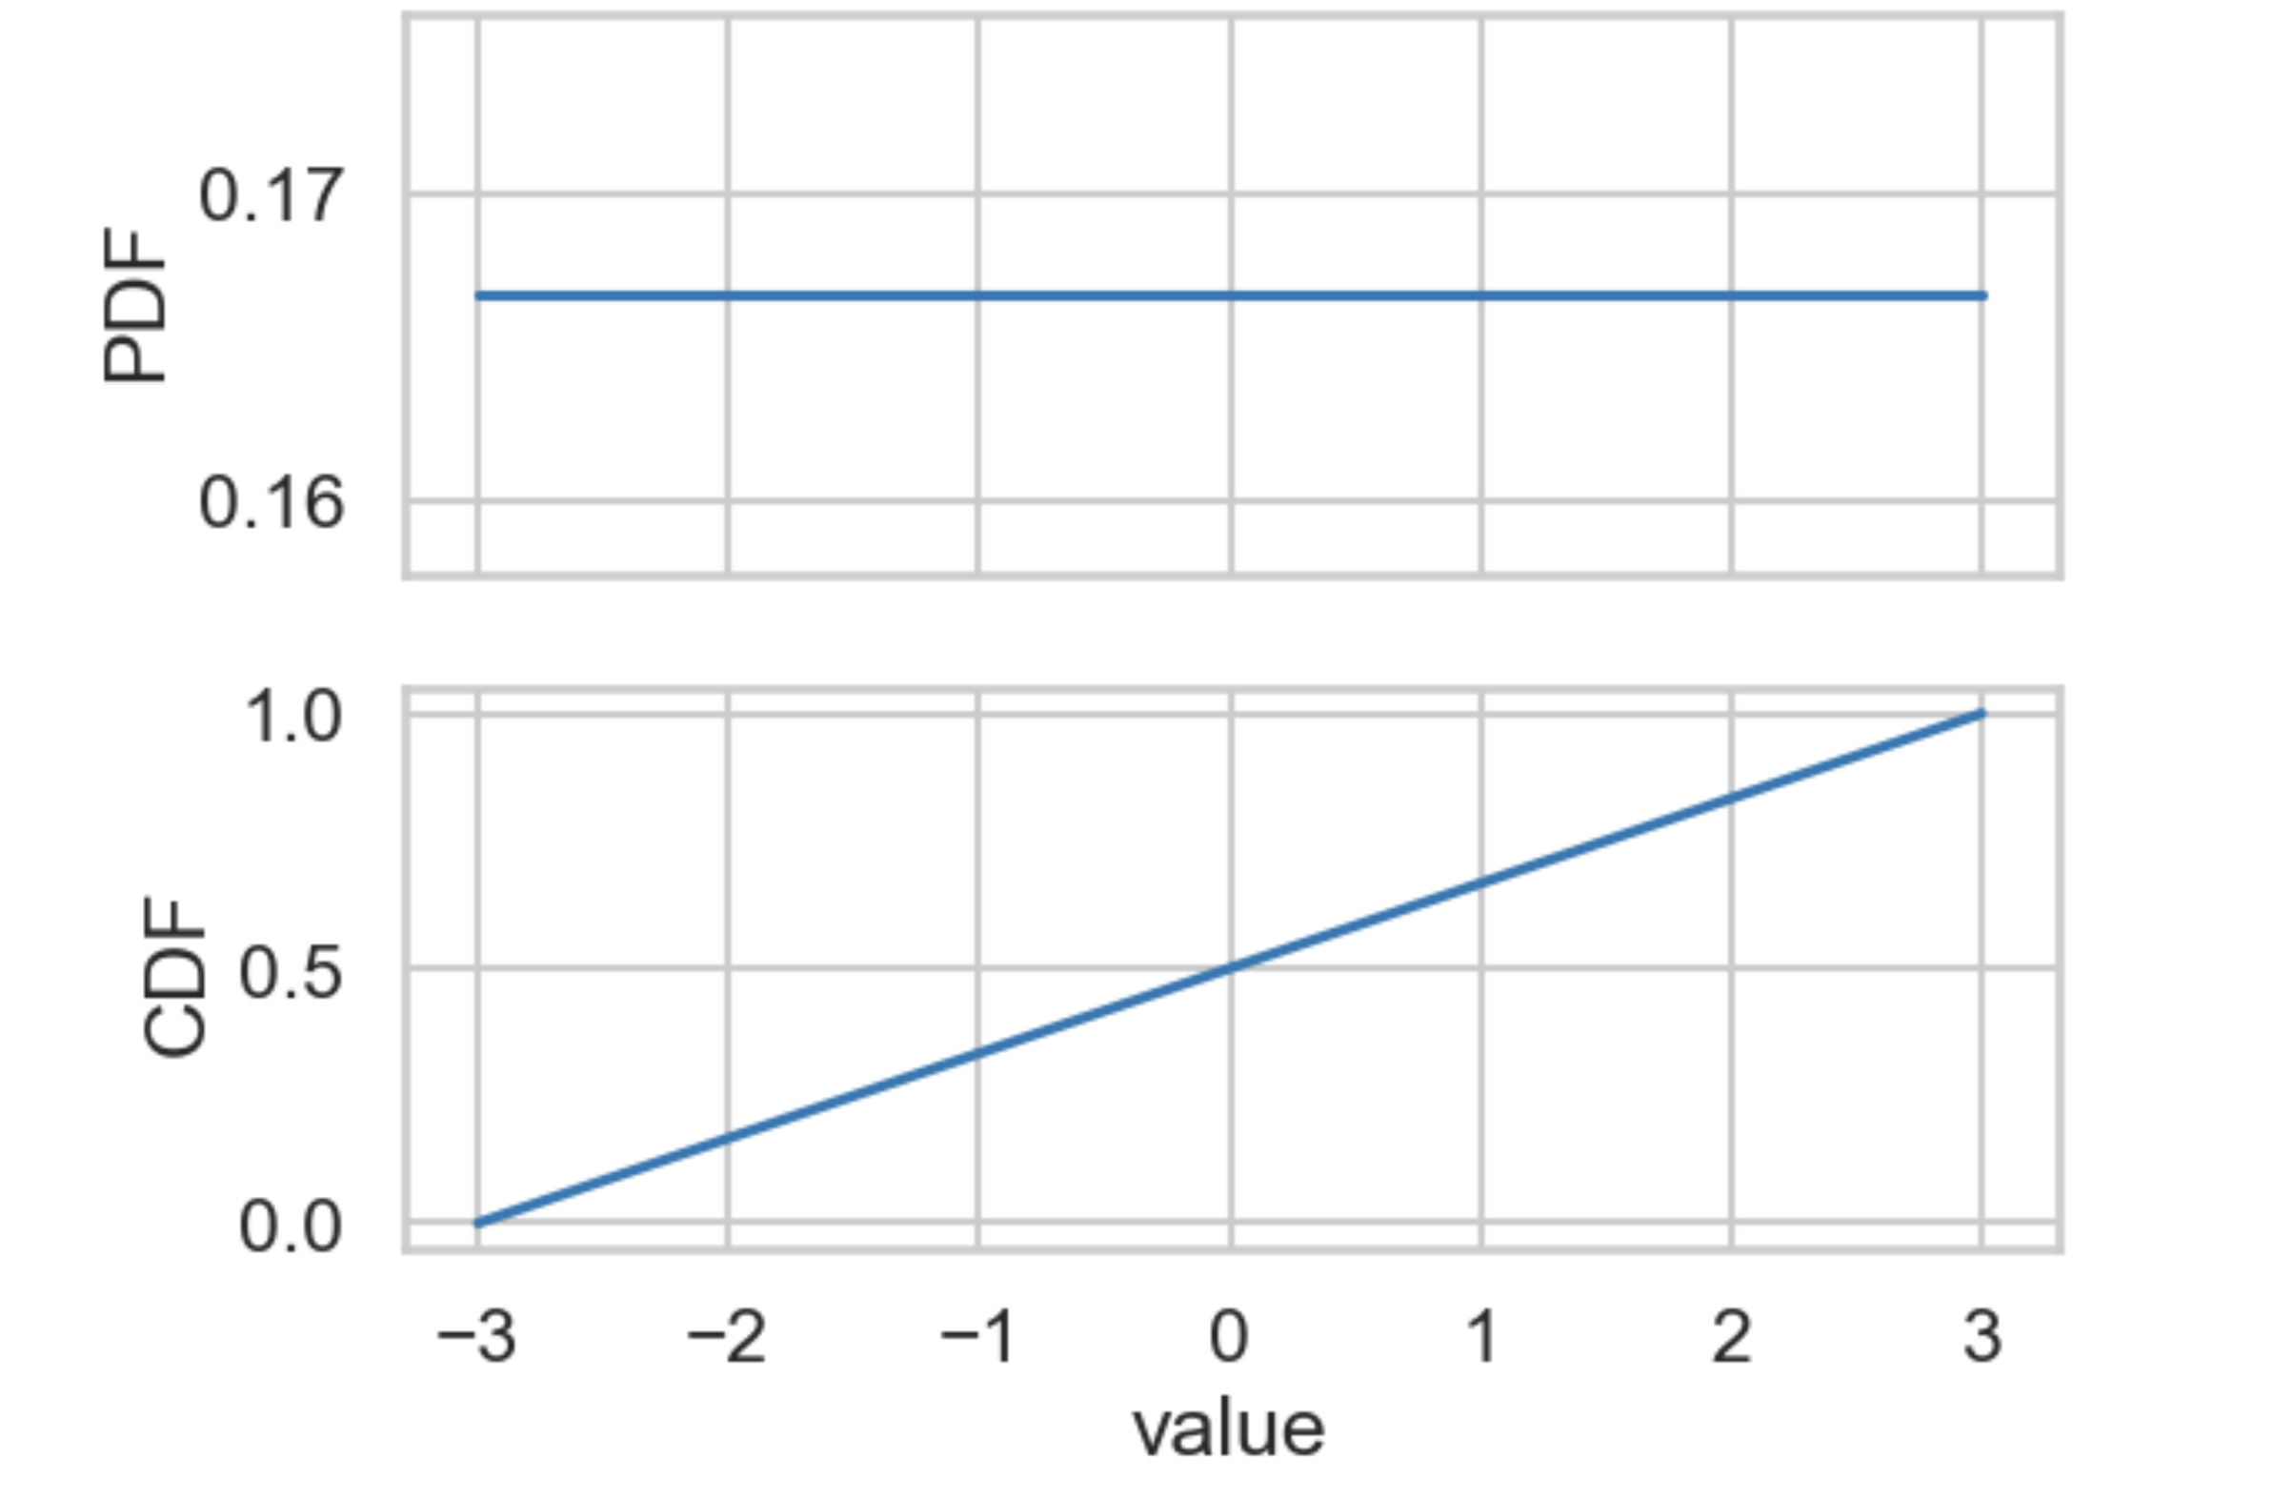

Slide 10
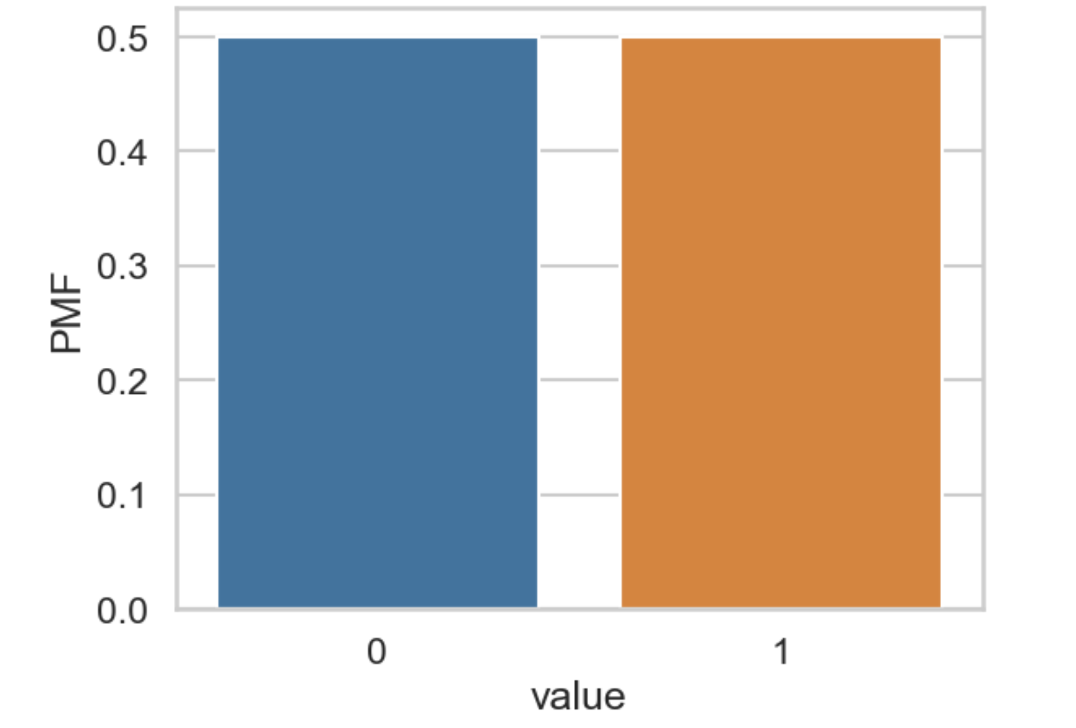

Slide 11
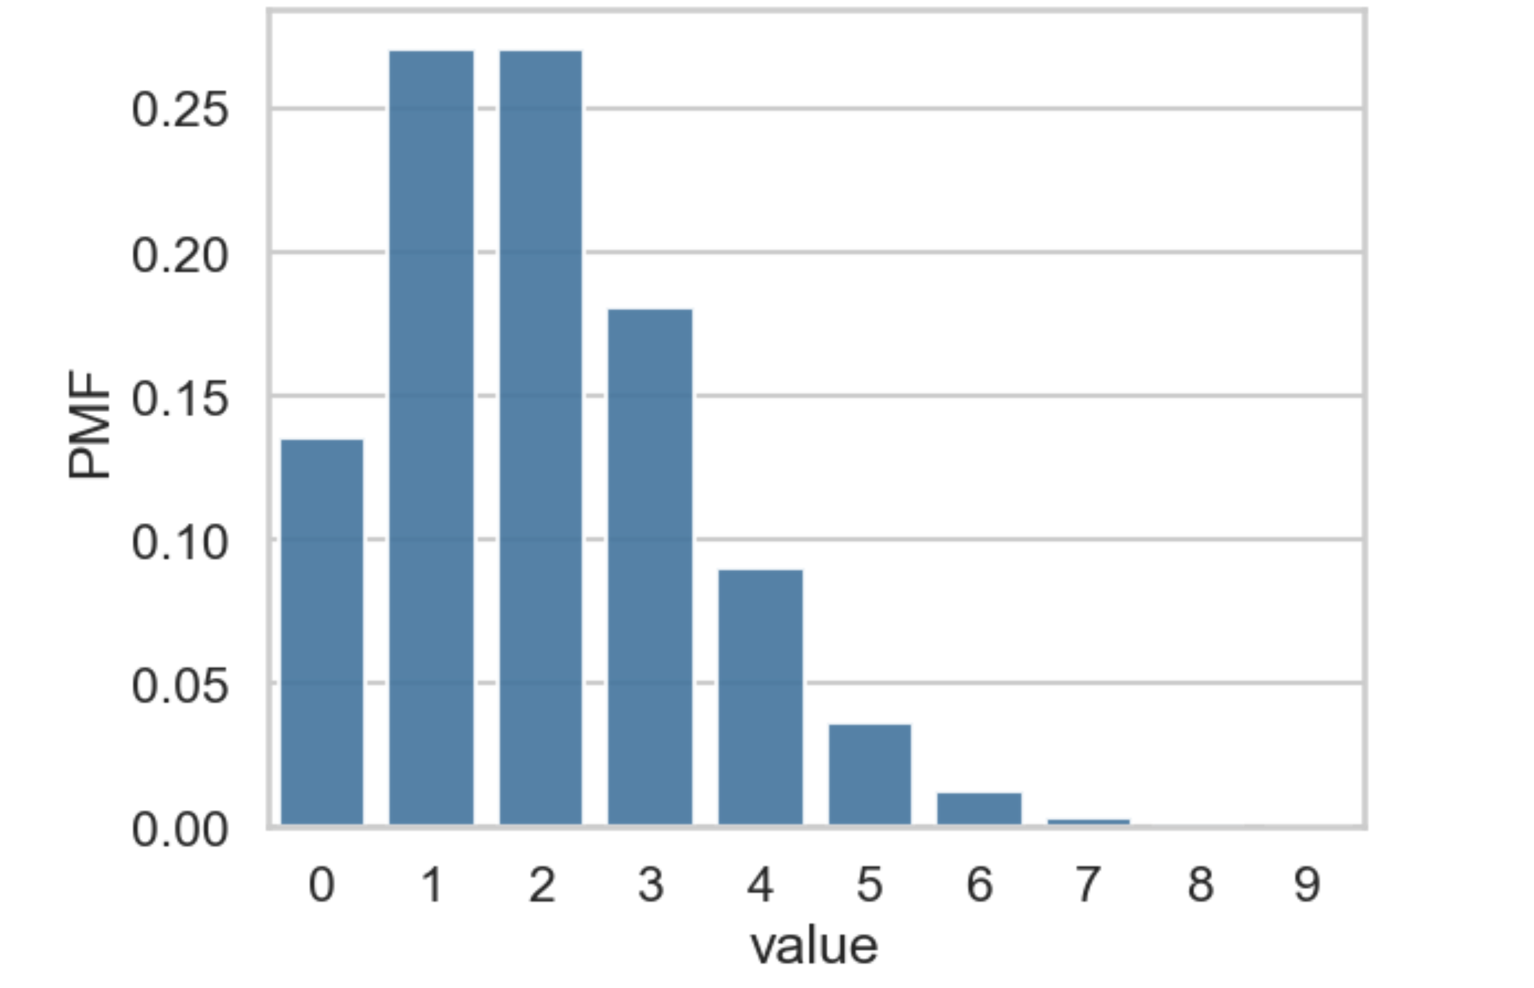

Slide 12
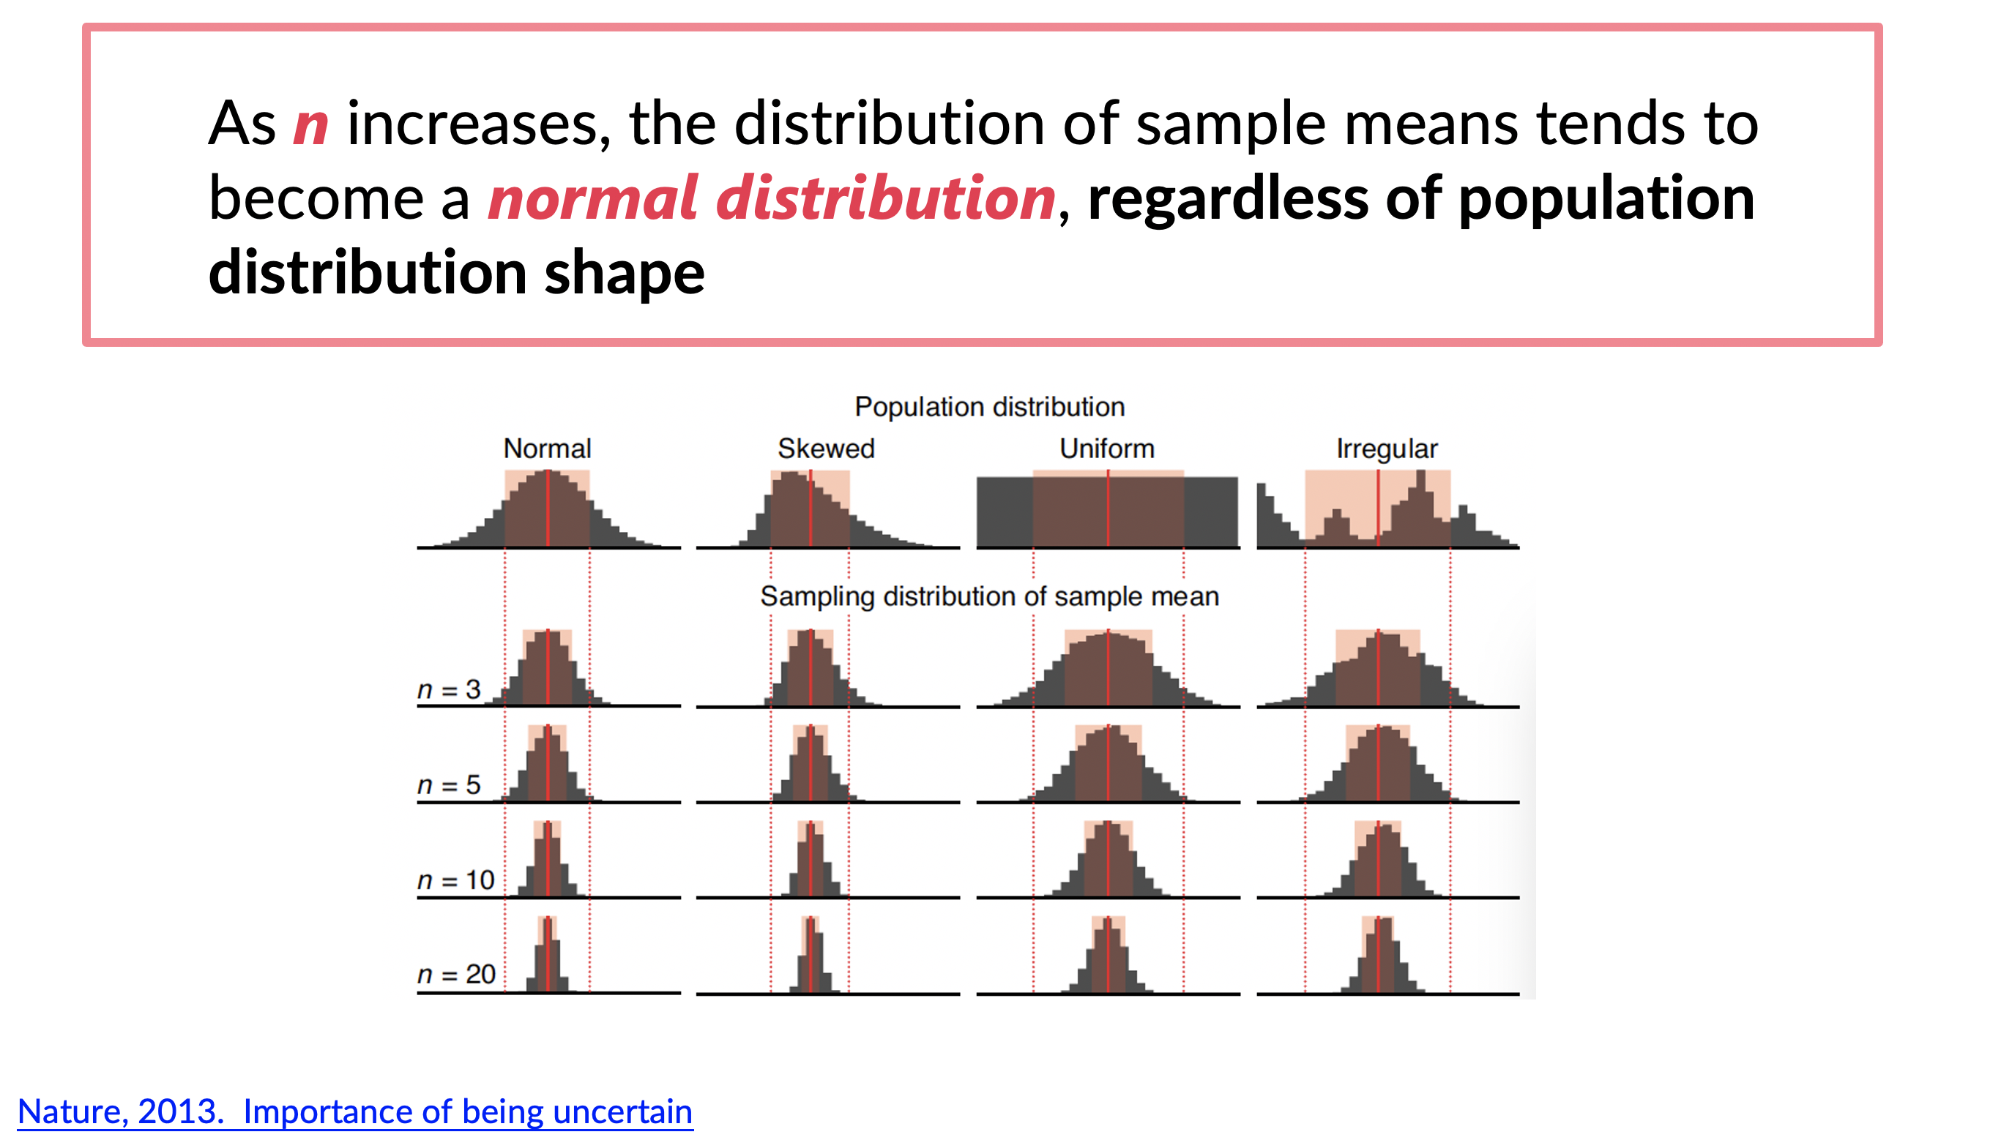

Slide 13
Distribution of means resembles T
Use T to compute probability width
True distribution
We take a samples
Compute sample means
95%
Confidence on Population mean

Slide 14
Distribution of means resembles T
Use T to compute probability width
True distribution
We take a samples
Compute sample means
95%
Confidence on sample
Distr. of statistic resembles T
Use T to compute probability width
True distribution
We take a samples
Compute sample statistic
95%
Confidence on Population statistic

Slide 15
True distribution
We take a samples
Compute sample statistic
Distr. of stat is known
Use to compute prob
95%
Confidence on Population statistic

Slide 17
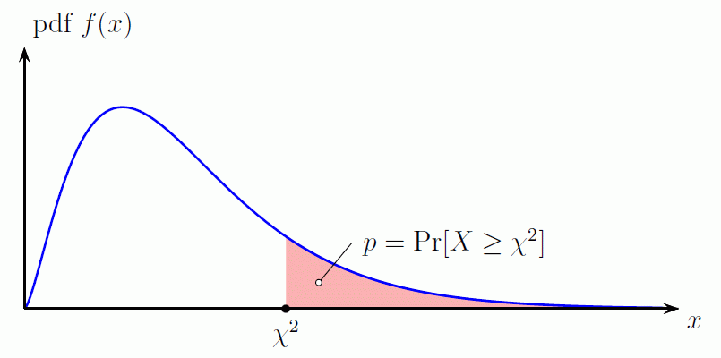

Slide 18
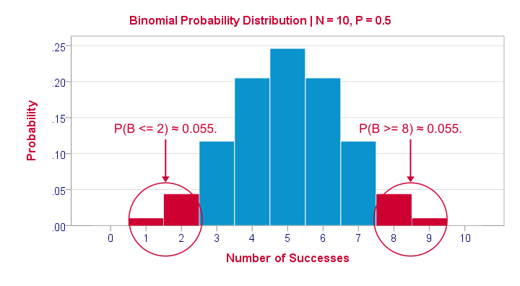

Slide 19

If you use a parametric test, and the assumption is wrong, your confidence level is not as meaningful
If you are not sure what distribution your sample statistic takes, you have to get tricky

Slide 20
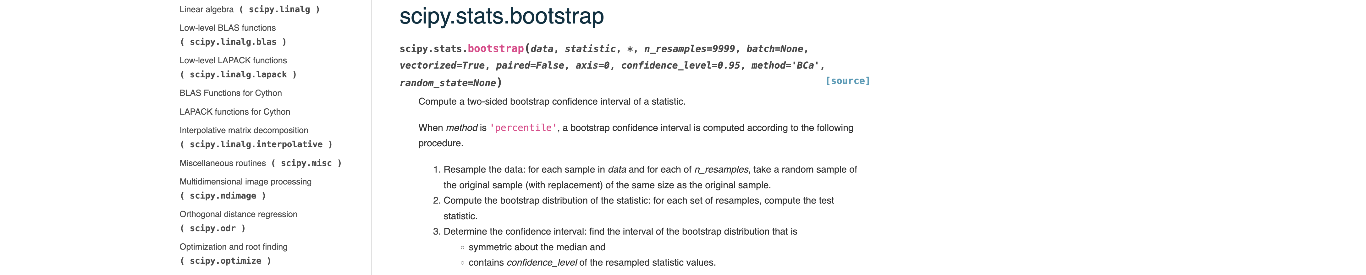

Slide 21

 | Parametric test (like T) | Bootstrapping
Pros | Need only 1 sample | Can use it for any statistic
 | Rigorous | Do not need to know underlying distribution
Cons | Must know the sample statistic’s underlying distribution | Must take many subsamples (can take a lot of time and computational power)
 |  | Not rigorous until infinite samples

